Slide 1
IT Infrastructure Architecture
Infrastructure Building Blocks
and Concepts
End user devices
(chapter 12)

Slide 2
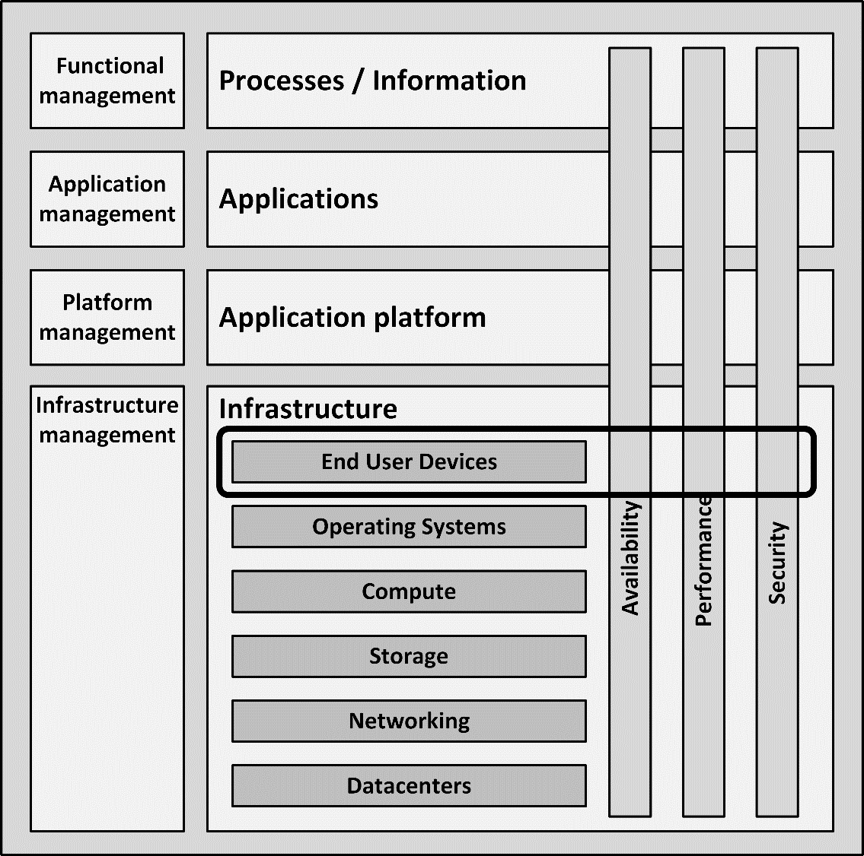
Introduction
Humans interact with applications using end user devices
Typical end user devices are:
Desktop PCs
Laptops
Virtual desktops
Mobile devices like phones and tablets
Printers

Slide 3
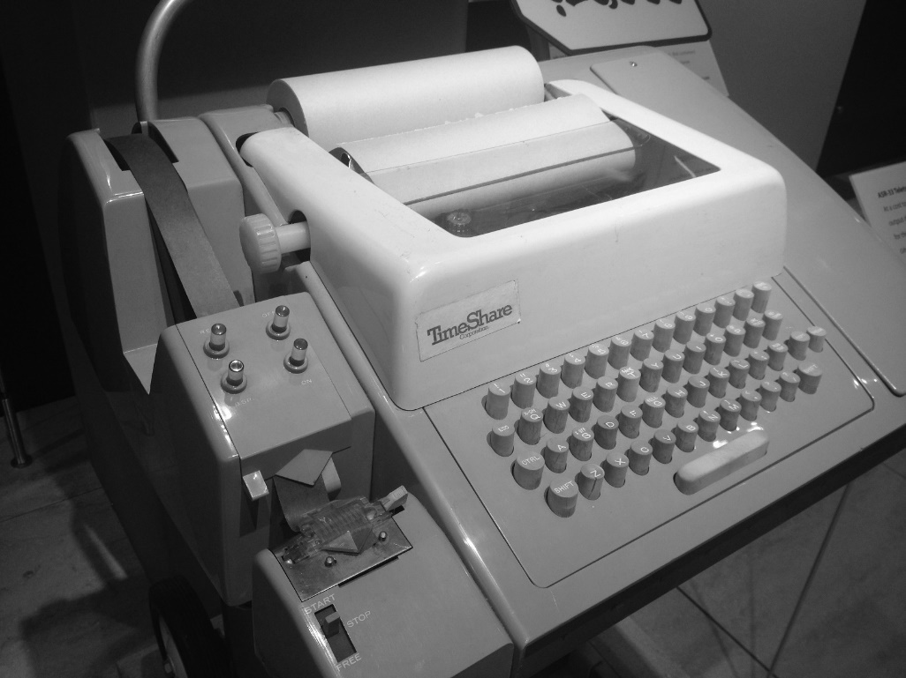
History
The first end user devices were teletypes
Teletypes were electromechanical typewriters
Provided a user interface to early mainframes
Sending typed data to the computer and printing the response

Slide 4
History
Electronic terminals replaced the teletypes
Terminals provided a monitor screen instead of printed paper
Allowing full screen editing and instant output
Terminals were “dumb”
Did not have their own processing power
Relayed typed-in commands to the mainframe computer and the mainframe computer sent data back to the terminal to be displayed
Terminals were used for decades to interact with mainframe and midrange computers

Slide 5
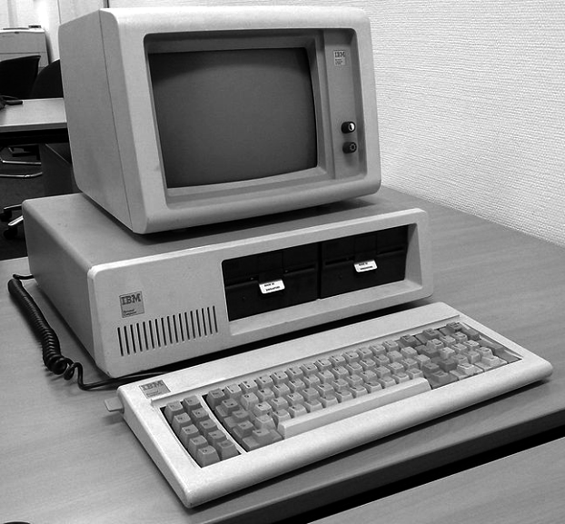
History - PC
In 1981, IBM introduced the Personal Computer (PC)
The IBM PC became the de facto end user device in many office environments
Office workers had full control over their own computer for the first time

Slide 6
History - PC
IBM developed the PC in about a year
The PC was built using "off-the-shelf" parts from a variety of manufacturers
Based on an open architecture
Enabling other manufacturers to produce and sell peripheral components and compatible software without having to purchase licenses
IBM sold an IBM PC Technical Reference Manual
Complete circuit diagrams
A listing of the ROM BIOS source code

Slide 7
History - PC
Many parties copied the PC
PC clones or IBM-compatible PCs
Built with:
The same architecture
The same chipset as the IBM PC
Reversed-engineered BIOS software
This allowed clones to run unmodified IBM software
One of the first and most successful companies building clones was Compaq, which would later become part of HP
All of the IBM PC software was developed by third parties
Microsoft provided the DOS operating system and office tools like Word and Excel

Slide 8
History - Apple
IBM was already a large manufacturer of computers before the introduction of the PC
Apple was founded by two hobbyists
In 1984, Apple introduced the Apple Macintosh
The first commercially successful personal computer to feature a mouse and a GUI rather than a command line interface
Designed to be used by consumers, and not as an office tool

Slide 9
History
Both the Mac and the PC evolved over time to become much faster
Color video screens and sound boards became the norm
Laptops became the most used form factor
The introduction of tablets and smartphones made the end user experience truly mobile

Slide 10
End user devices building blocks

Slide 11
Desktop PCs and laptops
Over the years, PCs have become very powerful
Can run complex software
Store relatively large amounts of data
Many organizations are searching for more cost-effective and simple solutions, because of:
The complexity of the PC itself
The very advanced operating systems
The amount of locally installed software
The performance, availability, and security issues related to all of these aspects

Slide 12
Desktop PCs and laptops
People are attached to their PCs
The term personal computer is still correct
Most users feel their PC is their personal tool that systems managers should not tamper with
This is why the adoption of alternatives like thin clients has never been very successful

Slide 13
Laptops
Most laptops are as powerful as desktop PCs
They are more "personal" than desktops
Users can take them home or use them on the road
Laptops have some disadvantages compared to desktop PCs:
Laptops frequently get lost or stolen
Laptops break more easily than desktops
They are more vulnerable to drops, bumps, coffee spills, etc.
The chance of illegal or malicious software being installed on the laptop is higher than on a desktop PC in the office
Most laptops are taken home every night,

Slide 14
Mobile devices
Mobile devices in the context of this course are devices that connect to the IT infrastructure using wireless public or off-site Wi-Fi networks
Typical mobile devices are:
Smartphones and tablets
Cars
Smart watches
Music players
Digital cameras
Computing power of mobile devices is getting comparable to desktop and laptop computers

Slide 15
Mobile devices
Specific properties:
Connect to the IT infrastructure using public networks
UMTS or LTE technology
Low bandwidth connectivity
Fluctuating connection speed
Low reliability of connections
Small form factor (screen, keyboard)
Applications’ user interfaces must be re-engineered to handle these smaller sizes

Slide 16
Bring Your Own Device (BYOD)
Most organizations use standard PCs or laptops with a limited set of business software
Users at home have access to:
Fast, sexy laptops of the brand they like
Tablets and smart phones that allow them to run thousands of highly attractive apps
Fast broadband internet connections that are often faster than the shared network in the office
A concept called Bring Your Own Device (BYOD) allows people to bring personally owned – typically mobile – devices to the office
Can be used to access the organization’s applications and data, as well as their personal applications and data

Slide 17
Bring Your Own Device (BYOD)
The BYOD concept creates a conflict of interests:
To optimize stability of the organization’s infrastructure and security, systems managers need to fully control the end user device
The owners of the devices want full freedom
The user paid for the device (they brought their own device), it will not be acceptable to:
Have systems managers erase the device (including all family photos or purchased music) in case of an incident
Have personal data visible to the systems managers

Slide 18
Bring Your Own Device (BYOD)
Virtualization techniques can be used to create isolated environments:
One virtual machine with access to the organization’s data and applications and is fully managed by the organization’s systems managers.
Managed using Mobile Device Management (MDM) software to monitor, maintain and secure virtual machines on mobile devices
When needed, the virtual machine can be remotely wiped to remove all sensitive data
One virtual machine that is owned and managed by the end user. This machine runs whatever applications the user wants
Both virtual machines use the same underlying hardware like network connectivity, touch screen, GPS, compass, and the sound system

Slide 19
Printers
Printers are used in almost all organizations to provide paper output
Most used printer types are:
Laser printers
Inkjet printers
Multi-Functional Printers
Specialized printers like:
Dot matrix printers
Line printers
Plotters
Thermal printers

Slide 20
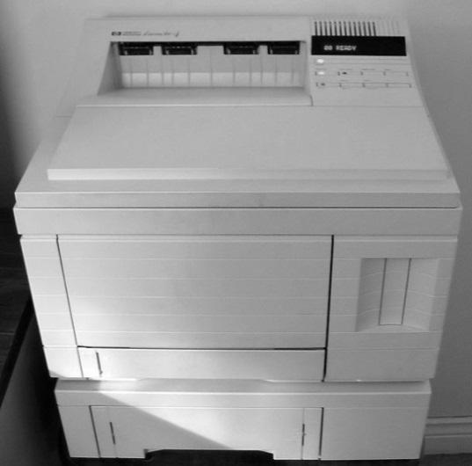
Laser printers
A laser printer rapidly produces high quality text and graphics on plain sheets of paper
Using ink powder, called toner
In color printers four toners are used, one for each basic color
Cyan
Magenta
Yellow
Black
Each color is put on paper separately

Slide 21
Laser printers
The image is produced using a photoreceptive drum
The drum is electrically charged using high voltages
The drum is lightened with a laser beam, which eliminates the electrostatic charge on all places, except the image
The electrostatic charge left on the drum attracts toner that transfers the image on paper
A fuser then heats the toner to burn it on paper

Slide 22
Inkjet printers
Inkjet printers create text and graphics by propelling droplets of ink onto paper through high print head resolution
Benefits with respect to laser printers:
No warm up time
Use much less energy
Relatively cheap
Produce high quality printouts, usually in color
Some professional inkjet printers provide wide format printing, with a print width ranging from 75 cm to 5 m
They can be used for instance to create advertising billboards

Slide 23
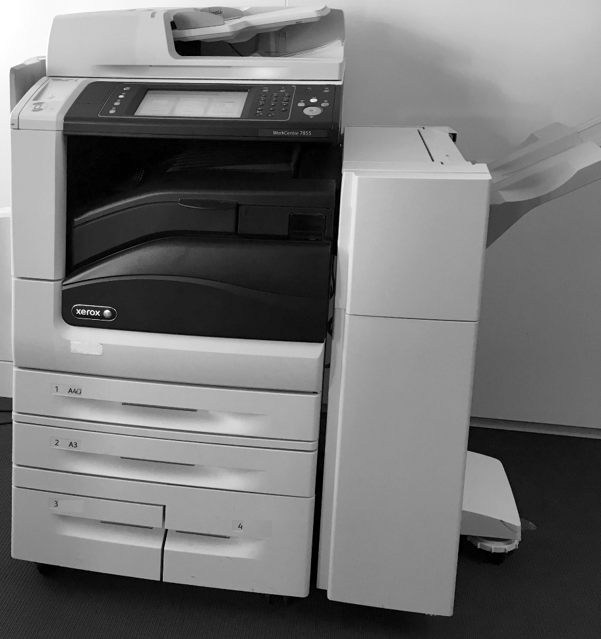
Multi-Functional Printers (MFPs)
A Multi-Function Printer (MFP) is an office device that acts as a:
Printer
Scanner
Photocopier
Fax machine
Provides centralized document management and production in an office setting

Slide 24
Multi-Functional Printers (MFPs)
Printing on demand
Printing only starts when a user is authenticated to the printer
No printed paper with possibly sensitive text is left on the MFP waiting to be collected
MFPs contain:
Memory
Processors
Storage, such as a hard disk drive or flash memory
An operating system
An MFP should be handled like a computer
Patches must be installed
The hard drive should be erased before repair

Slide 25
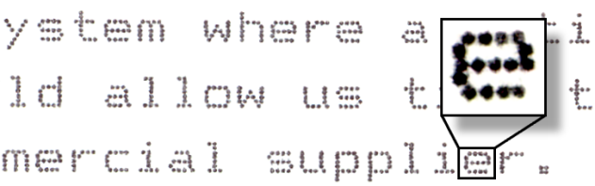
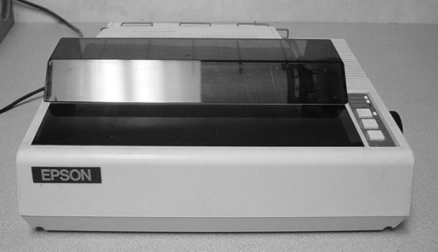
Specialized printers - Dot Matrix printers
In dot matrix printers, characters are drawn out of a matrix of dots
Each dot is produced by a tiny metal rod driven forward by a tiny electromagnet
The moving portion of the printer is called the print head
Prints one line of text at a time, character-by-character
Noisy during operation as a result of the hammer-like mechanism in the print head
Uses continuous fanfold paper rather than cut-sheets

Slide 26
Specialized printers - Dot Matrix printers
From the 1970s until the 1990s, dot matrix printers were by far the most common type of printer used with personal computers
Dot matrix printers:
Can print on multi-part stationery or make carbon-copies, used for instance for printing invoices
Have one of the lowest printing costs per page
Use continuous paper rather than individual sheets
Dot matrix printers are very reliable work horses and are therefore still in use in many places

Slide 27
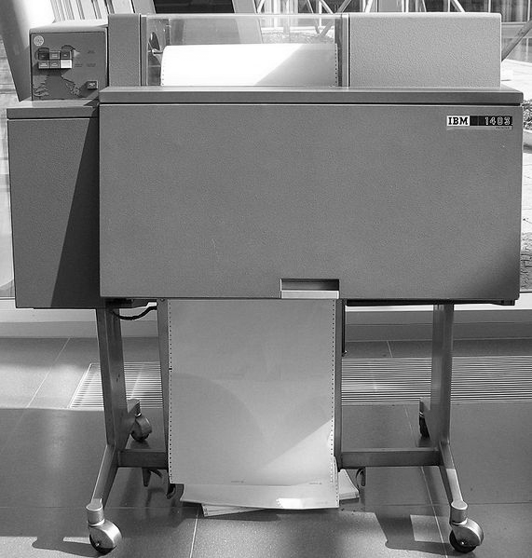
Specialized printers - Line printers
Line printers are high speed printers that print one complete line of text at once
600 to 1200 lines per minute
Multiple technologies:
Spinning drums
Chains
Bands
that contain the character set
Small hammers are used to push the paper to the passing characters at exactly the right moment, putting the characters on paper

Slide 28
Specialized printers - Line printers
Line printers are especially well-suited to shop floors and industrial environments
They use continuous fanfold paper rather than cut-sheets
Line printers are physically more durable than laser printers
Their consumables are both less costly and less harmful to the environment

Slide 29
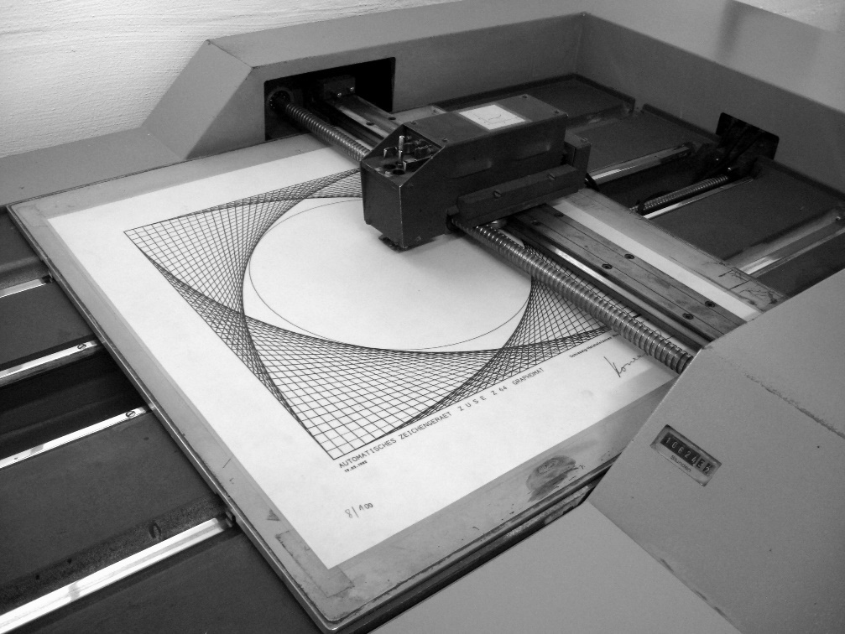
Specialized printers - Plotters
A plotter is a specialized printer that draws vector graphics using a pen
Mainly used in computer-aided design, for creating blueprints
Either the pen moves, or the paper
Plotters can draw high quality complex line art, including text
They are slow because of the mechanical movement of the pen and paper
Most plotters have been replaced by large-format inkjet printers

Slide 30
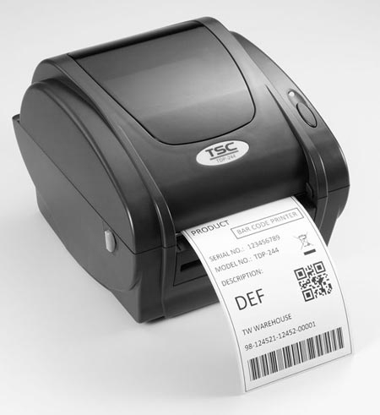
Specialized printers - Thermal printers
A thermal printer produces a printed image by selectively heating thermal paper when the paper passes over the thermal print head
Thermal paper is impregnated with a chemical that changes color when exposed to heat
Thermal printers are
Quiet
Fast
Small
Low power
Ideal for portable and retail applications like point of sale terminals and voucher printers
Drawback: the image disappears exposed to sunlight or heat

Slide 31
Desktop virtualization
Virtualization technologies for end user devices:
Application virtualization
Run applications on an underlying virtualized operating system
Virtualized PCs based on:
Server Based Computing (SBC)
Virtual Desktop Infrastructure (VDI)

Slide 32
Application virtualization
Application virtualization is typically implemented in a Windows-based environment
The term application virtualization is a bit misleading:
The application itself is not virtualized
The operating system resources the application uses are virtualized
Application virtualization isolates applications from some resources of the underlying operating system and from other applications
The application virtualization layer provides the application with virtualized parts of the runtime environment normally provided by the operating system
The application assumes it is directly interfacing with the operating system

Slide 33
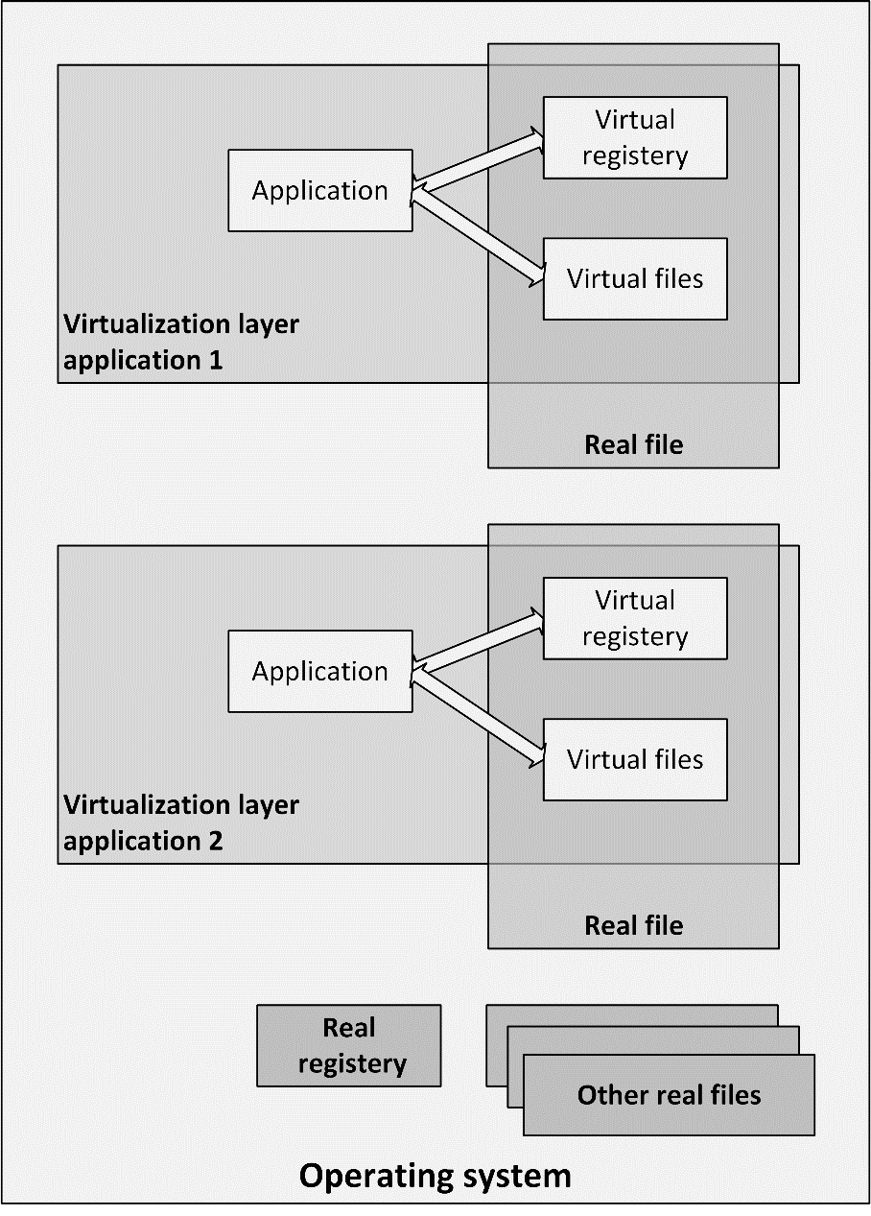
Application virtualization

Slide 34
Application virtualization
The application virtualization layer:
Proxies all requests to the operating system
Intercepts all file and registry operations
These are transparently redirected to a virtualized location, often a single real file
The application is working with one file, not many files and registry entries spread throughout the system
It becomes easy to run the application on a different computer
Previously incompatible applications or application versions can be run side-by-side
Examples:
Microsoft App-V
VMware ThinApp

Slide 35
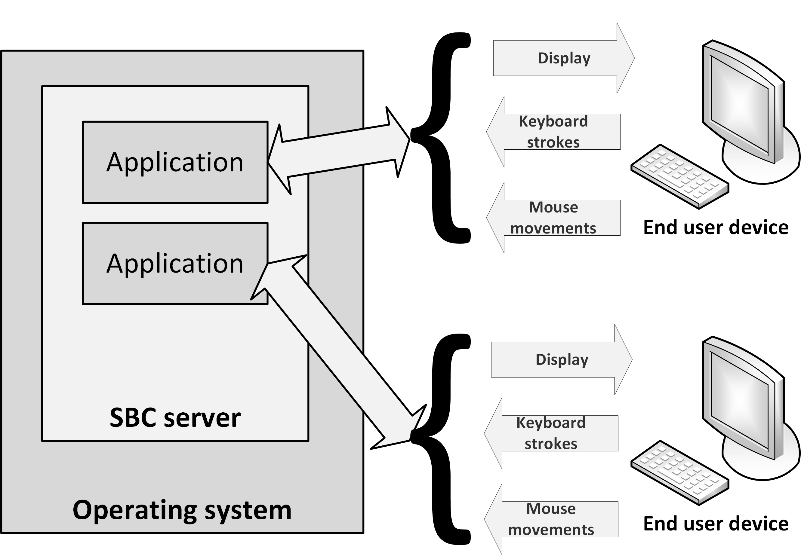
Server Based Computing
Server Based Computing (SBC) is a concept where applications and/or desktops run on remote servers
They relay their virtual display to the user's device
Keyboard and mouse information is processed by the application on the server
The resulting display changes are sent back to the user device

Slide 36
Server Based Computing
The user’s device runs a lightweight application (a thin client) that:
Displays the video output from the server
Fetches the keyboard strokes from the client
Fetches mouse movements from the client
Sends client input back to the application on the remote server
SBC requires a limited amount of network bandwidth:
Only changed display information is sent to the end user device
Only keyboard strokes and mouse movements are sent to the server

Slide 37
Server Based Computing
SBC is typically implemented in a Windows based environment
SBC products:
Windows Remote Desktop Service (RDS, formerly known as Windows Terminal Services)
Citrix XenApp (formerly known as MetaFrame Presentation Server)
RDS is part of the Windows operating system
XenApp provides more functionality than RDS, but is a separate product

Slide 38
Server Based Computing
Advantages of SBC:
Maintenance (like applying patches and upgrades) can be done at the server level
The changes are available instantly to all users
Application configurations are the same for all users
Disadvantages:
Graphical properties of the SBC server are used instead of that of the client end user device
Limitations on the desktop experience (slow response or keyboard lag) are mostly due to network latency or the configuration of the remote desktop

Slide 39
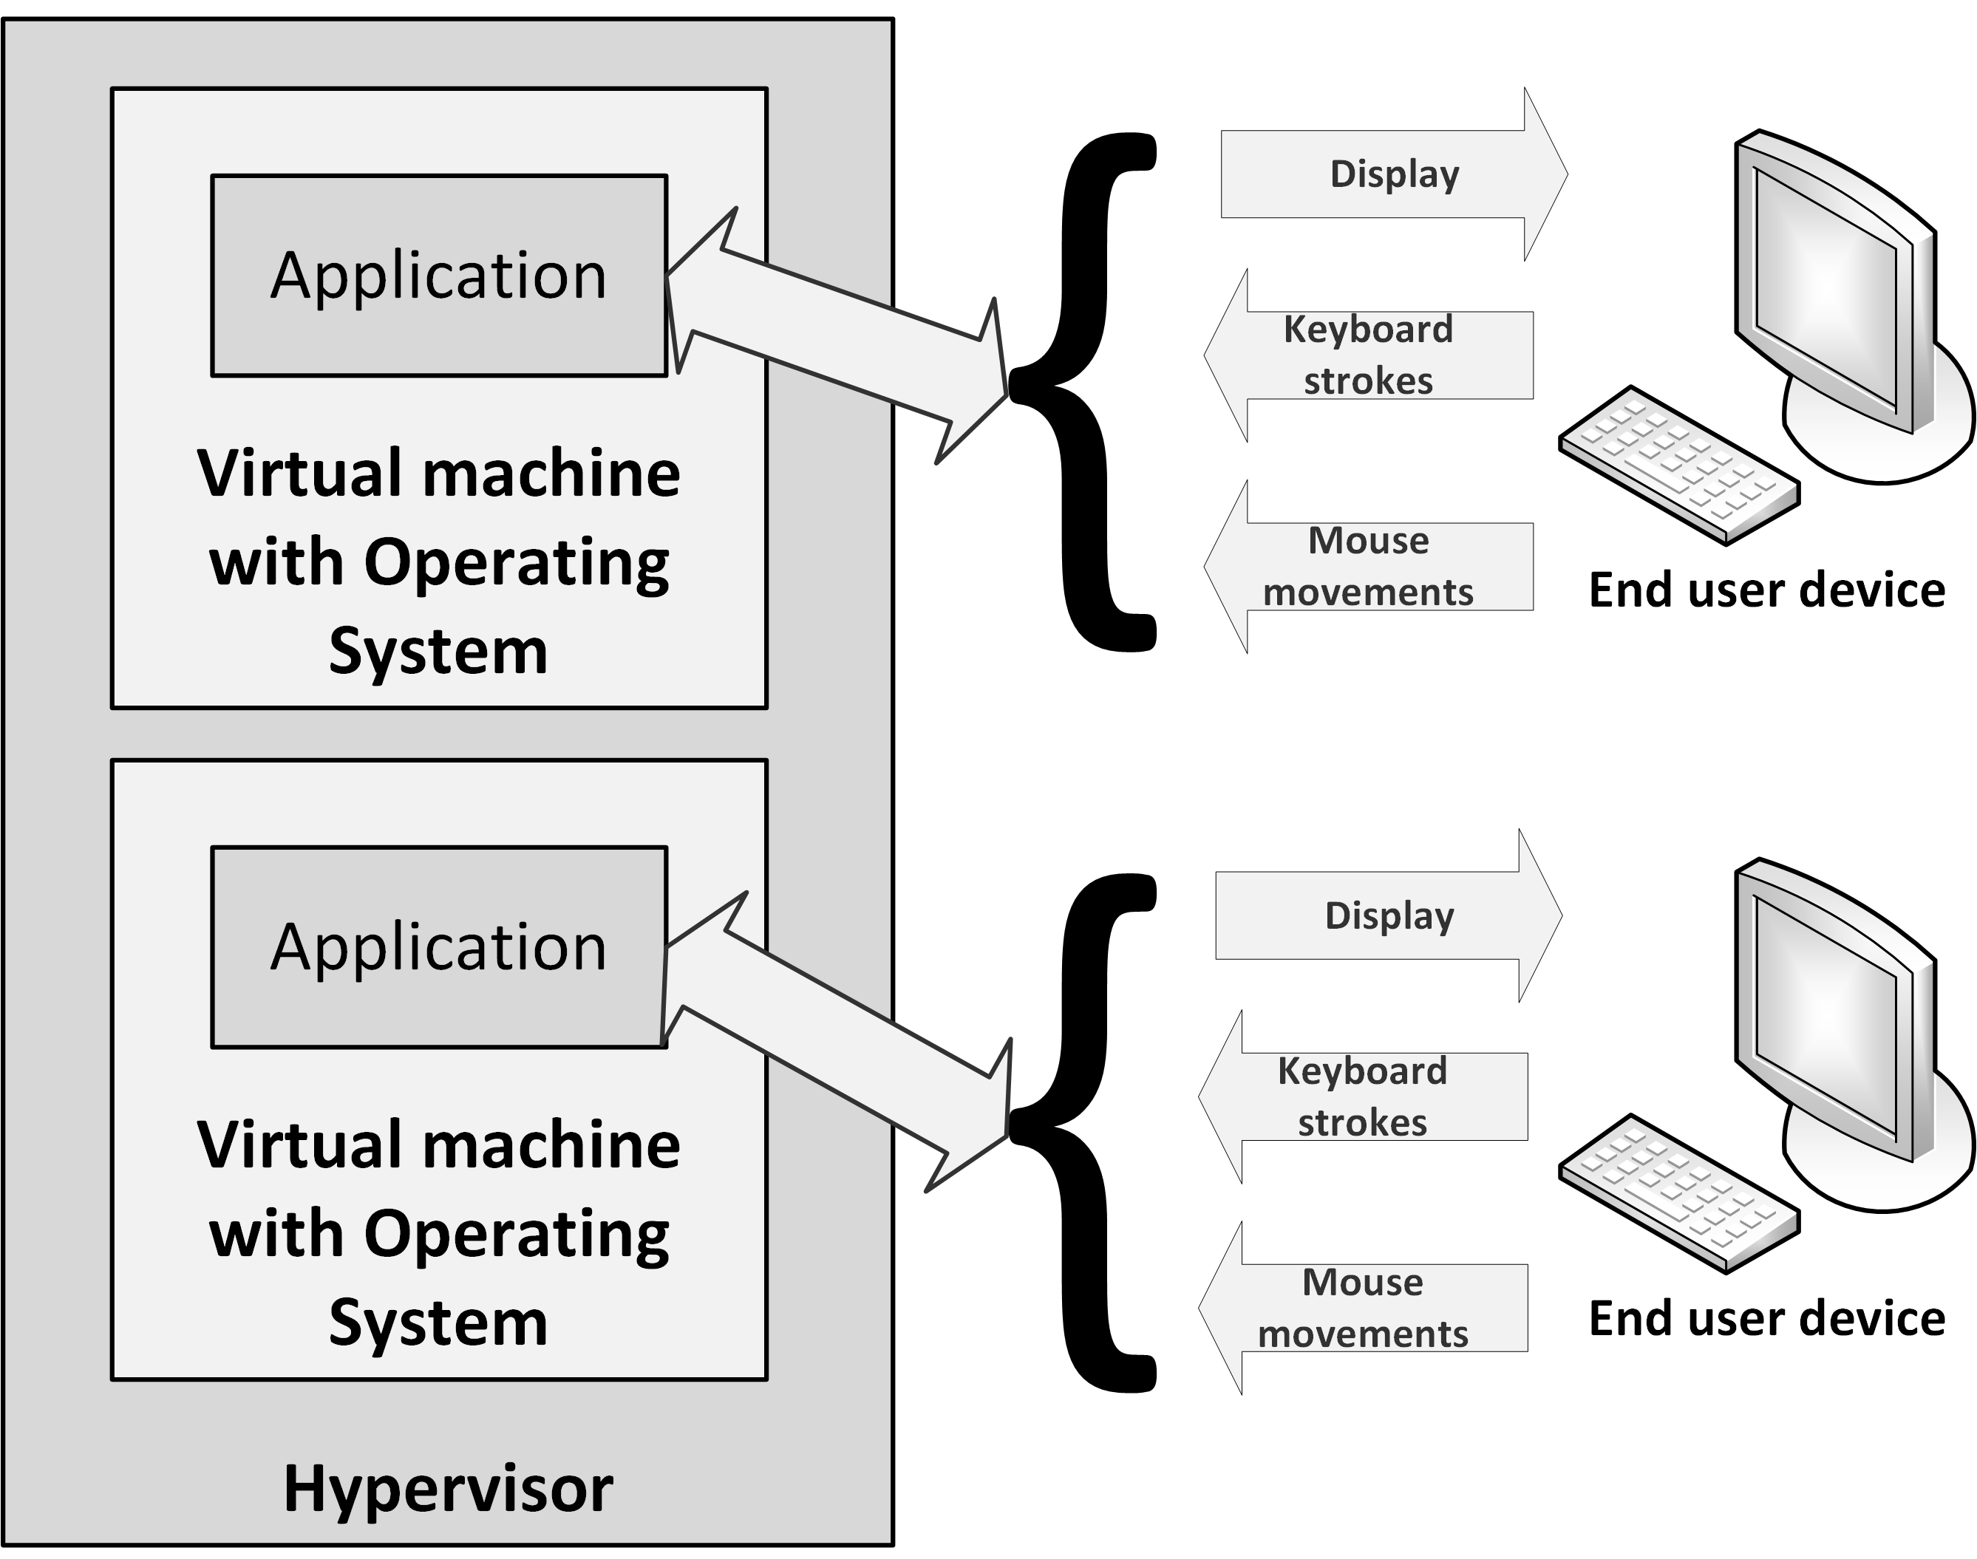
Virtual Desktop Infrastructure (VDI)
Virtual Desktop Infrastructure (VDI) is a similar concept as SBC
In VDI, user applications run in their own virtual machine
The hypervisor's primary task is to distribute available hardware resources between VDI machines on a physical machine

Slide 40
Virtual Desktop Infrastructure (VDI)
With VDI, each user has exclusive use of the operating system, CPU, and RAM
SBC users share these resources
VDI enables applications and operating systems to run next to each other in complete isolation without interference
VDI tends not to scale well in terms of CPU resources and storage IOPS
Each client uses an entire virtual machine
A 'Logon storm' occurs when many virtualized systems boot up at the same time
Logon storms can partly be prevented by pre-starting a predefined number of virtual machines at configured time slots

Slide 41
Thin clients
VDI and SBC both enable the hosting of desktops on central server farms and use the same protocols to deliver the output of application screens to users
Thin clients communicate with the SBC or VDI server
Hardware:
Lightweight computers, inexpensive, have no moving parts or local disk drives
Have no configuration; can be used directly after plugging them into the network
Easy to replace when one fails
No regular upgrades or systems management needed
Software:
Applications running in a normal client operating system
Runs on mobile devices like tablets and smartphones

Slide 42
PXE boot
The Preboot eXecution Environment (PXE) allows desktop PCs or thin clients to boot from an operating system disk image stored on the network instead of from a local hard disk
This allows for diskless thin clients
The BIOS tries to locate a PXE boot server on the network
For PXE to work, the PC always needs a network connection
Not suitable for mobile devices like laptops
Implementing a high performing TFTP server is crucial for fast start-up times

Slide 43
End user devices availability

Slide 44
Reliability
End user devices’ hardware is much less reliable than hardware installed in the datacentre
To keep the cost low
Designed to last only 3 to 5 years
Mobile devices like laptops or tablets can get physically damaged quite easily
Leading to hardware failures
Typical failures are hard disk crashes in laptops or screen cracks in tablets
A failing end user device immediately leads to downtime for a user
Loss of availability of business functions to the end user

Slide 45
Backup of end user devices
Backup of local disks is very important
Most of the work worldwide is first saved to a local disk on an end user device
Automated synchronization of local data to a server can be implemented
For end users, it should be impossible to disable this synchronization function
End user devices should be protected from random installs of potential bad software by end users

Slide 46
End user devices performance

Slide 47
End user device performance
Performance of end user devices is in most cases not a big issue
PCs and laptops:
Adding more RAM increases the performance more than choosing a faster CPU
A faster disk – preferably an SSD disk – can positively affect the performance
Most data processed on a PC of laptop is transferred using the network
Make sure enough bandwidth is available for each end user device

Slide 48
End user device performance
Ensure software running on mobile devices is capable of handling low bandwidth and unreliable connectivity
End user devices are often used with public wireless networks (like public Wi-Fi, or 3G)
Technologies like Server Based Computing can help to make mitigate the effect of low bandwidth

Slide 49
End user devices security

Slide 50
End user device security
Securing end user devices is quite a challenge
They are not located in a locked down datacentre
They are spread around offices, homes and client locations
Some tips:
Provide users with laptop cable locks to physically lock the laptop to an unmovable object to prevent theft.
If end user devices are at the end-of-life, or when they need repair, fully erase the hard disk first
Malware protection software like a virus scanner needs to be installed on each device
Laptops and PCs can contain a large amount of (business critical) data – encrypt the full hard disk!

Slide 51
Mobile device management
Mobile device management (MDM) can be used to monitor, maintain and secure devices that are not regularly connected to the organization’s network
When a mobile device is stolen, MDM enables systems management to remotely erase the device’s content
Software to locate the stolen device can be installed to help law enforcement locating the device and arresting the thief

Slide 52
End user authorizations and awareness
End users should not be able to remove important software or alter system files or log files
They should not have the administrator password of their device
When users need to install software, they could be given the right to do so, without giving them the administrator password of their device
BIOS passwords can be used on laptops and desktops to further increase security
BIOS setting should be applied to prevent booting from USB sticks or DVD drives
Users need to be aware of common security guidelines including:
The possibility of social engineering
Using strong passwords
Knowing how to handle sensitive data

